Slide 1


ARTICLES

Slide 2
A AN THE
A CAR
A FILM
A BOOK
AN ORANGE
AN E-MAIL
AN HOUR
THE FIRST
THE ATLANTIC OCEAN

Slide 3


Use A/AN
with professions and jobs: She is a teacher.
I am a pupil.
He is an engineer

Slide 4


Use A/AN
with a singular noun that you mention for the first time:
This is a table.
There is an orange there.

Slide 5

Use THE
when you have already mentioned the noun:
The table is brown.
The orange is cut.

Slide 6
Use THE
when it’s clear what you are talking about:
The pupils in my class are hardworking.
The tables in my classroom are very old.

Slide 7

Use THE
with ordinal numbers:
the first
the second

Slide 8

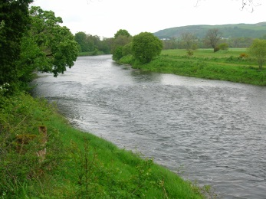
Use THE
with the names of seas, oceans and rivers
the Atlantic Ocean
the Adriatic Sea
the Sava

Slide 9
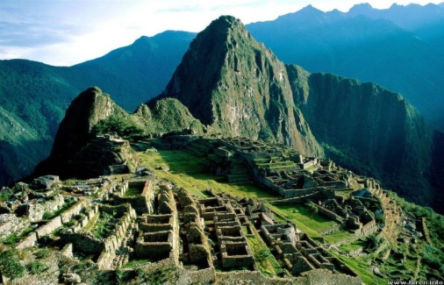
Use THE
with the names of people, islands and mountains in the plural:
the Azores
the Bahamas
the Incas
the Vikings
the Alps

Slide 10
NO ARTICLE
with geographical names in the singular:
Zagreb
Asia Scotland
Greece Stonehenge
Croatia

